Slide 1
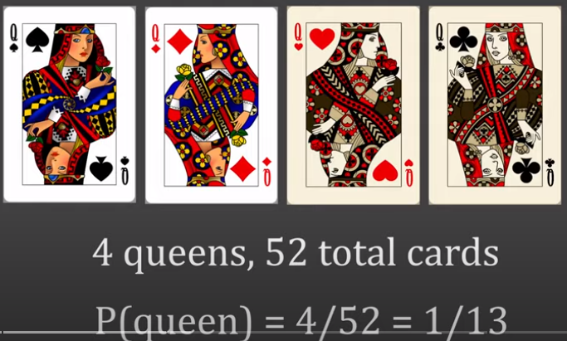



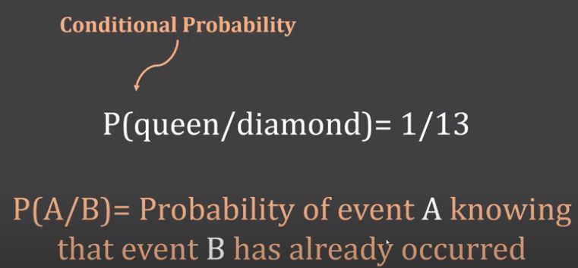
Basics of Probability

Slide 2
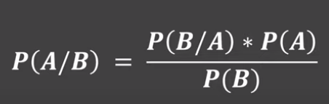
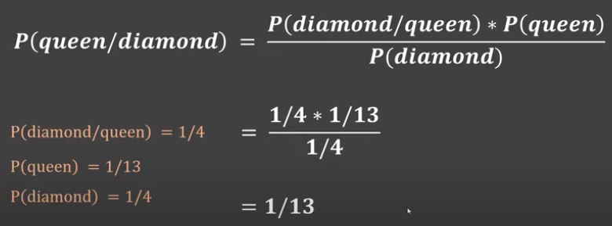

Slide 3
BAYESIAN CLASSIFICATION
Bayesian Classifiers
Bayesian classifiers are statistical classifiers
They can calculate the probability that a given sample belongs to a particular class
Bayesian classification is based on Bayes theorem
Bayesian classifiers have exhibited high accuracy and speed when applied to large databases

Slide 4
BAYESIAN CLASSIFICATION
Bayes Theorem
Let X be a data sample, e.g. red and round fruit
Let H be some hypothesis, such as that X belongs to a specified class C (e.g. X is an apple)
For classification problems, we want to determine P(H|X), the probability that the hypothesis H holds given the observed data sample X

Slide 5
BAYESIAN CLASSIFICATION
Prior Probability
The probability P(H) is called the prior probability of H, i.e the probability that any given data sample is an apple, regardless of how the data sample looks
The probability P(H|X) is called posterior probability. It is based on more information, then the prior probability P(H) which is independent of X

Slide 6
BAYESIAN CLASSIFICATION
Posterior Probability
Example:
Let the data samples be fruits described by their colour and shape
Suppose X = red and round
and H = hypothesis that X is an apple
Then P(H|X) is the probability that X is an apple given that X is red and round

Slide 7
BAYESIAN CLASSIFICATION
Bayes Theorem
It provides a way of calculating the posterior probability
P(H|X) = P(X|H) P(H)
P(X)
P(X|H) is the posterior probability of X given H (it is the probability that X is red and round given that X is an apple)
P(X) is the prior probability of X (probability that a data sample is red and round)

Slide 8
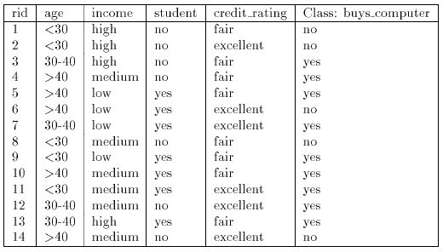
BAYESIAN CLASSIFICATION
Naïve (Simple) Bayesian Classification
Example:

Slide 9
BAYESIAN CLASSIFICATION
Naïve (Simple) Bayesian Classification
Example:
Let C₁ = class buy computer and C₂ = class not buy computer
The unknown sample:
X = {age ≤ 30, income = medium, student = yes, credit-rating = fair}
The prior probability of each class can be computed as
P(buy computer = yes) = 9/14 = 0.643
P(buy_computer = no) = 5/14 = 0.357

Slide 10
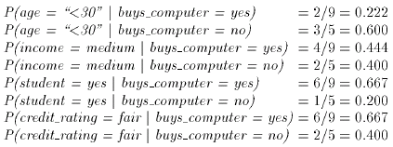
BAYESIAN CLASSIFICATION
Naïve (Simple) Bayesian Classification
Example:
To compute P(X|Ci) we compute the following conditional probabilities

Slide 11
BAYESIAN CLASSIFICATION
Naïve (Simple) Bayesian Classification
Example:
Using the above probabilities we obtain
And hence the naïve Bayesian classifier predicts that the student will buy computer, because

Slide 12
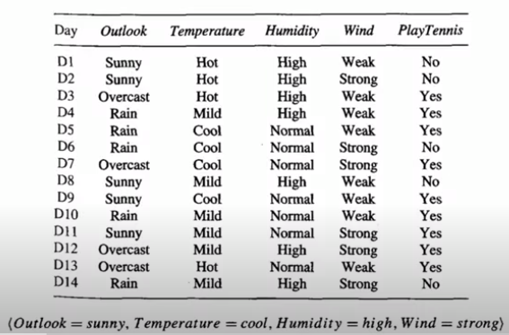
New Instance

Slide 13
We want to classify the new instance in either YES or NO
We need to calculate the Prior Probabilities and Current Probabilities
Prior Probabilities in this case is the probability of YES and probability of NO
Count number of times YES is appearing
Count number of times NO is appearing
Total instances = 14
YES = 9
NO = 5

Slide 14
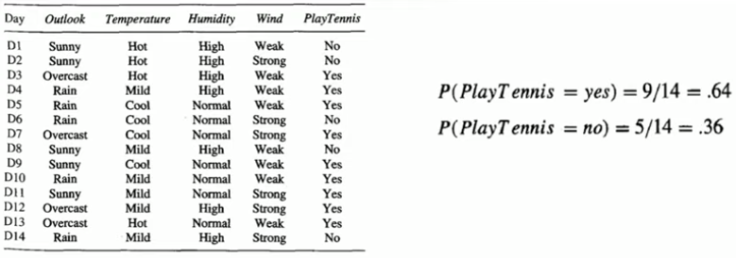

Slide 15
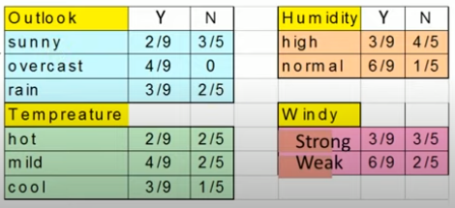
Now we need to calculate the current probabilities or conditional probabilities of the individual attributes
As we have four attributes
Temperature Humidity Wind and Outlook
So we will calculate conditional probabilities of all these attributes
9 YES instances and 5 NO instances
Count number of times sunny is appearing in YES and NO respectively
Similarly for Overcast and Rain
Similarly calculate for all the attributes

Slide 16
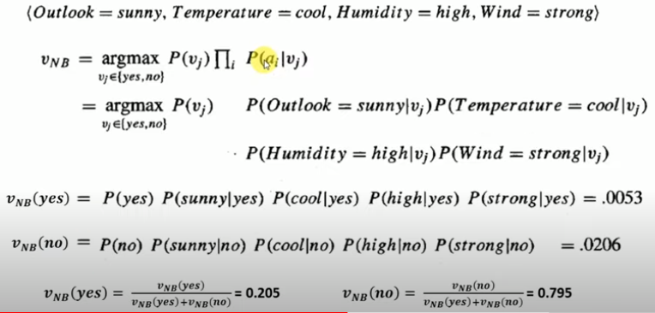
Now lets classify the new instance
a_{i}
is the given new instance values
V_{j}
Possible outcome class
Probability normalization formula
Highest probability gives the class of the new instance
Adding both probabilities will result in 1

Slide 17
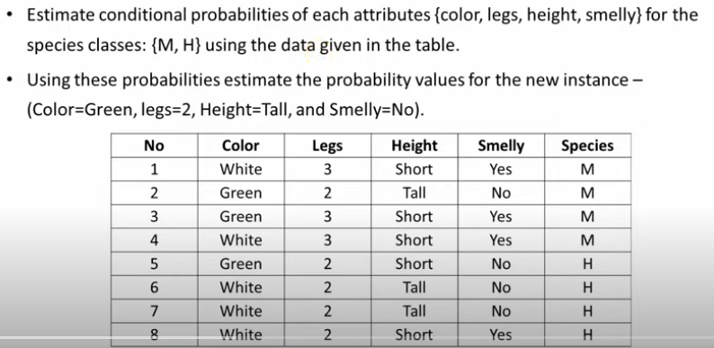

Slide 18
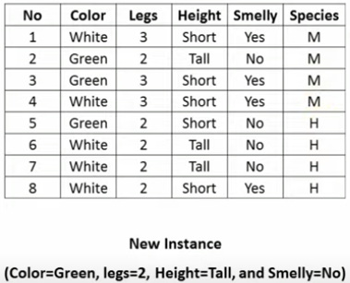

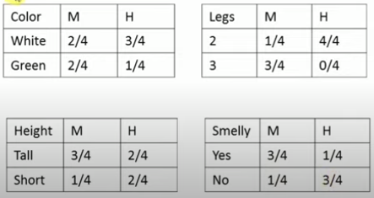
Prior Probabilities
Conditional Probabilities

Slide 19
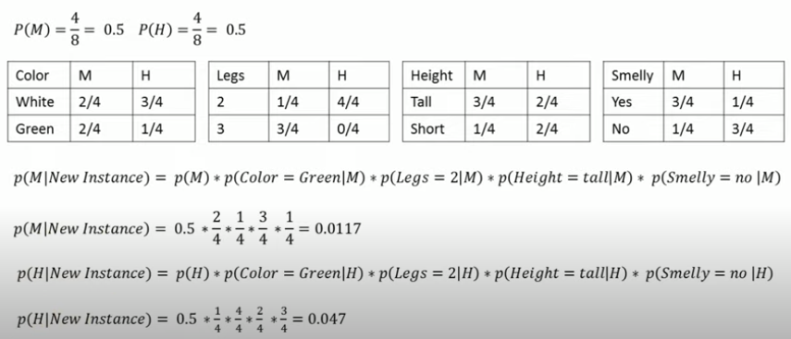

Slide 20
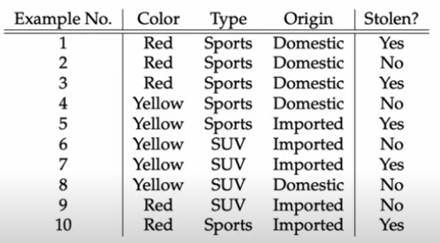

Slide 21
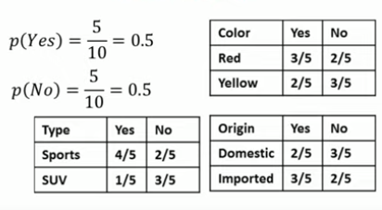
Calculate Prior and Conditional Probabilities

Slide 22
